Slide 1
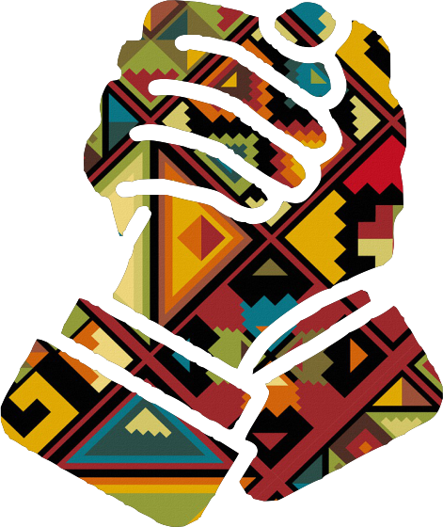

United Together!

Slide 2
UN SDG Chosen and Problem Statement
UN SDG Chosen
  We Chose “INDUSTRY, INNOVATION AND INFRASTRUCTURE” as our UN Suitable Development Goal.
Problem Statement
  - Current technology is fastly progressing but does not solve our everyday socio-economic issues faster and as a result, social development becomes very slow and more and more problems arise.
  - As a result, problems like poverty, hunger, unemployment, no decent work and economic growth, crime and corruption are constantly rising which causes more serious problems and worsens current problems related to the above mentioned problems.
  - Innovation is slowly decreasing and ends up affecting economic and industry development which leads to low quality infrastructure or none at all.

Slide 3
Solution
- We made a user friendly mobile application for all users (citizens and companies).
- Our app increases innovation which will lead to industry development.
- Users will be able to post their requests and read news letters.
- The app allows companies to give back to communities by accepting citizens’ requests and to participate in socio-economic development.
-There is a newsletter detailing completed projects and the companies that were involved in completeing them.

Slide 4
Technology used
- Our application is an android mobile application.
- Up to 3 programming languages to construct the app, namely JAVA, mySQL and php script, and we also used the lamp server for our database.
- We used android studio to develop the application.
- And we stored the app’s data in a lamp server using php scripts.

Slide 5
What makes our solution unique
  - Our solution is unique as it addresses not one but up to 13 suitable development goals.
  - Both citizens and companies benefit from using the application.
  - Our solution is compleling and through our application, companies feel the need to give back to communities which also helps them grow, and citizens also have a wide-access platform to make requests to their everyday problems.
  - The app reduces the time communities spend waiting for government services which rarely happen nowadays due to corruption.

